Slide 1
LINKED LIST
BY
ARAVINDH SUBRAMANIYAN L
ASHWIN MUTHU KUMAR S

Slide 2
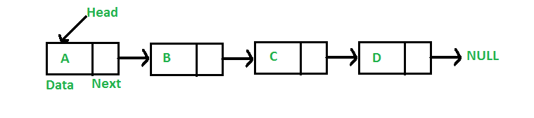
LINKED LIST INTRODUCTION
Like arrays, Linked List is a linear data structure. Unlike arrays, linked list elements are not stored at a contiguous location; the elements are linked using pointers.

Slide 3
WHY LINKED LIST?
Arrays can be used to store linear data of similar types, but arrays have the following limitations.
1) The size of the arrays is fixed: So we must know the upper limit on the number of elements in advance. Also, generally, the allocated memory is equal to the upper limit irrespective of the usage.
2) Inserting a new element in an array of elements is expensive because the room has to be created for the new elements and to create room existing elements have to be shifted.

Slide 4
For example, in a system, if we maintain a sorted list of IDs in an array id[].
id[] = [1000, 1010, 1050, 2000, 2040].
And if we want to insert a new ID 1005, then to maintain the sorted order, we have to move all the elements after 1000 (excluding 1000).
Deletion is also expensive with arrays until unless some special techniques are used. For example, to delete 1010 in id[], everything after 1010 has to be moved.

Slide 5
ADVANTAGES OVER ARRAYS
1) Dynamic size
2) Ease of insertion/deletion

Slide 6
DRAWBACKS
1) Random access is not allowed. We have to access elements sequentially starting from the first node. So we cannot do binary search with linked lists efficiently with its default implementation.
2) Extra memory space for a pointer is required with each element of the list.
3) Not cache friendly. Since array elements are contiguous locations, there is locality of reference which is not there in case of linked lists.

Slide 7
REPRESENTATION
A linked list is represented by a pointer to the first node of the linked list. The first node is called the
head. If the linked list is empty, then the value of the head is NULL.Each node in a list consists of at least two parts:
1) data
2) Pointer (Or Reference) to the next node

Slide 8
contd...
In C, we can represent a node using structures. Below is an example of a linked list node with integer data.In Java or C#, LinkedList can be represented as a class and a Node as a separate class. The LinkedList class contains a reference of Node class type.
// A linked list node
struct Node {
int data;
struct Node* next;
};

Slide 9
First Simple Linked List in C Let us create a simple linked list with 3 nodes.
#include <bits/stdc++.h> using namespace std; class Node { public: int data; Node* next; }; int main() { Node* head = NULL; Node* second = NULL; Node* third = NULL; head = new Node(); second = new Node(); third = new Node(); head->data = 1; head->next = second; second->data = 2; second->data = 2; third->data = 3; // assign data to third node third->next = NULL; return 0; }

Slide 10
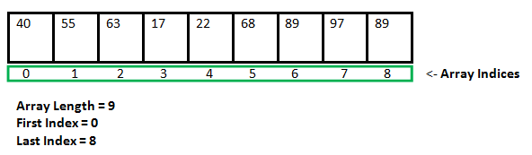
LINKED LIST VS ARRAY
Both Arrays and Linked List can be used to store linear data of similar types, but they both have some advantages and disadvantages over each other.

Slide 11
ADVANTAGES
1) Dynamic size
2) Ease of insertion/deletion

Slide 12
DISADVANTAGES
1) Random access is not allowed. We have to access elements sequentially starting from the first node. So we cannot do a binary search with linked lists.
2) Extra memory space for a pointer is required with each element of the list.
3) Arrays have better cache locality that can make a pretty big difference in performance.

Slide 13
INSERTION
A node can be added in three ways
1) At the front of the linked list
2) After a given node.
3) At the end of the linked list.

Slide 14
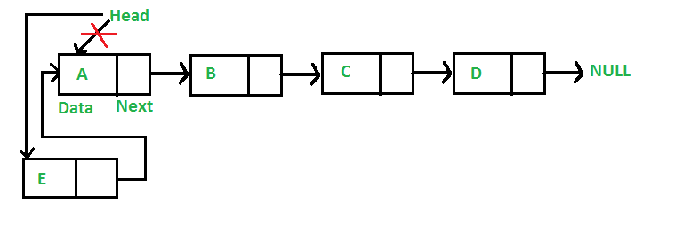
ADD A NODE AT THE FRONT
Time complexity of push() is O(1) as it does constant amount of work.

Slide 15
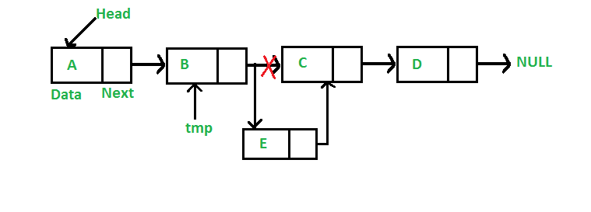
ADD A NODE AFTER A GIVEN NODE
Time complexity of insertAfter() is O(1) as it does constant amount of work.

Slide 16
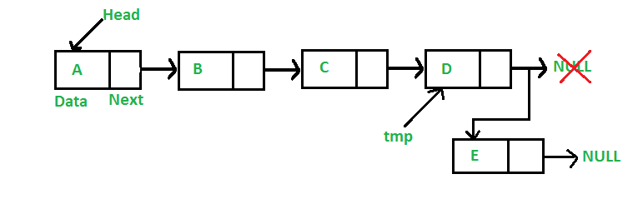
ADD A NODE AT THE END
Time complexity of append is O(n) where n is the number of nodes in linked list. Since there is a loop from head to end, the function does O(n) work.
This method can also be optimized to work in O(1) by keeping an extra pointer to tail of linked list

Slide 17
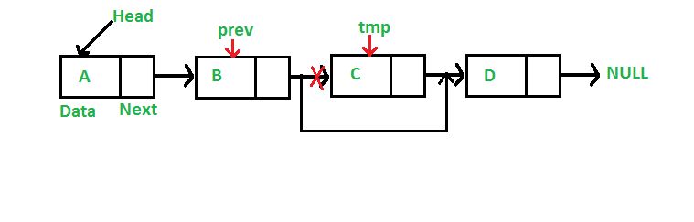
DELETION(GIVEN A KEY)
Let us formulate the problem statement to understand the deletion process. Given a ‘key’, delete the first occurrence of this key in the linked list.
To delete a node from the linked list, we need to do the following steps.
Find the previous node of the node to be deleted.
Change the next of the previous node.
Free memory for the node to be deleted.
Since every node of the linked list is dynamically allocated using malloc() in C, we need to call free() for freeing memory allocated for the node to be deleted.

Slide 18
Delete a Linked List node at a given position
If the node to be deleted is the root, simply delete it. To delete a middle node, we must have a pointer to the node previous to the node to be deleted. So if positions are not zero, we run a loop position-1 times and get a pointer to the previous node.

Slide 19
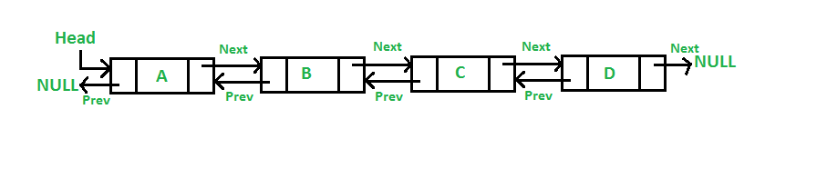
DOUBLY LINKED LIST
A Doubly Linked List (DLL) contains an extra pointer, typically called previous pointer, together with next pointer and data which are there in singly linked list.
struct Node {
int data;
struct Node* next;
struct Node* prev;
};

Slide 20
ADVANTAGES OVER SINGLY LINKED LIST
1) A DLL can be traversed in both forward and backward direction.
2) The delete operation in DLL is more efficient if pointer to the node to be deleted is given.
3) We can quickly insert a new node before a given node.
In singly linked list, to delete a node, pointer to the previous node is needed. To get this previous node, sometimes the list is traversed. In DLL, we can get the previous node using previous pointer.

Slide 21
DISADVANTAGES OVER SINGLY LINKED LIST
1) Every node of DLL Require extra space for an previous pointer. It is possible to implement DLL with single pointer though
2) All operations require an extra pointer previous to be maintained. For example, in insertion, we need to modify previous pointers together with next pointers. For example in following functions for insertions at different positions, we need 1 or 2 extra steps to set previous pointer

Slide 22
INSERTION
A node can be added in four ways
1) At the front of the DLL
2) After a given node.
3) At the end of the DLL
4) Before a given node.

Slide 23
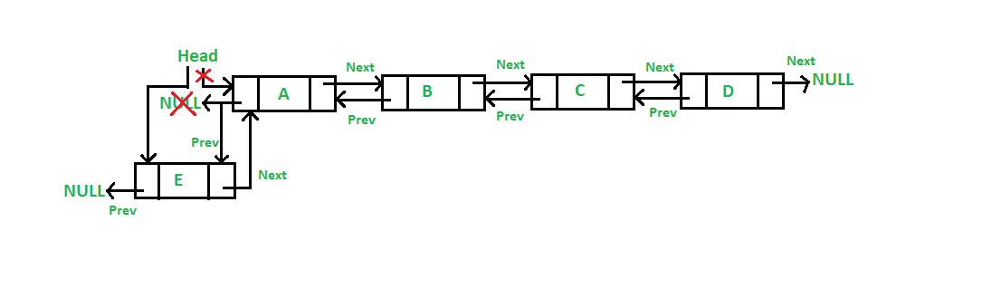
ADD A NODE AT THE FRONT

Slide 24
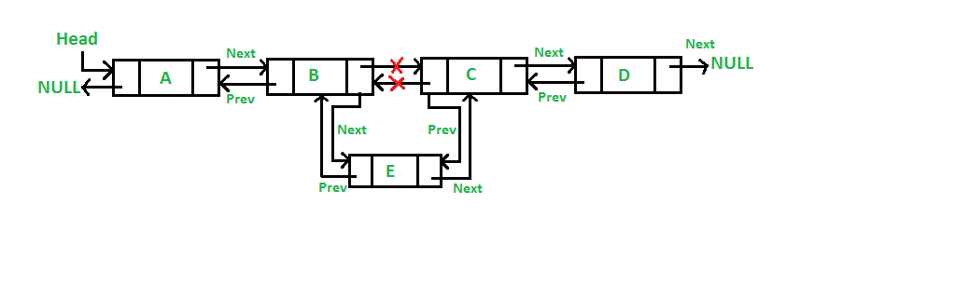
ADD A NODE AFTER A GIVEN NODE.

Slide 25
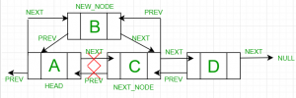
ADD A NODE BEFORE A GIVEN NODE

Slide 26
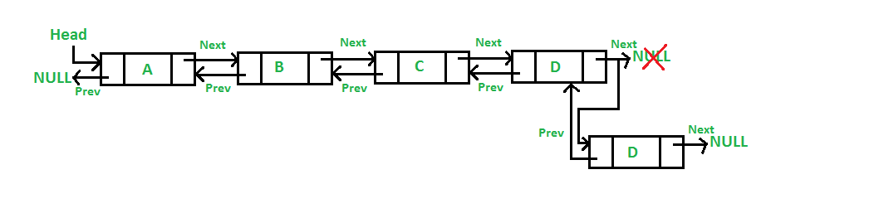
ADD A NODE AT THE END

Slide 27
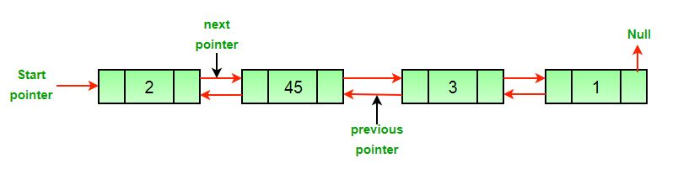
DELETION
Original doubly linked list

Slide 28
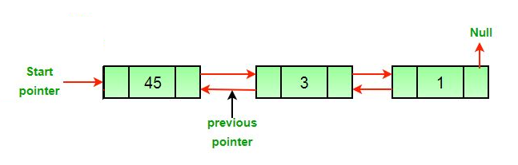
APPROACH
THE DELETION OF A NODE IN A DOUBLY LINKED LIST CAN BE DIVIDED INTO THREE MAIN CATEGORIES:
After the deletion of the head node.

Slide 29
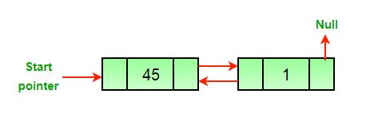
AFTER THE DELETION OF THE MIDDLE NODE.

Slide 30
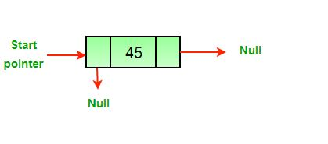
AFTER THE DELETION OF THE LAST NODE.

Slide 31
COMPLEXITY ANALYSIS
Time Complexity: O(1). Since traversal of the linked list is not required so the time complexity is constant.
Space Complexity: O(1). As no extra space is required, so the space complexity is constant.

